Slide 1
Programming Challenge
Don Loree’s Customizable Text to Speech Application
Paul Laffon, Cédric Paris, Omar Rabie, Mackenzie Van Vliet
{laffonp, parisc, rabieo, vanvlm1} @ mcmaster.ca
Group 102

Slide 2
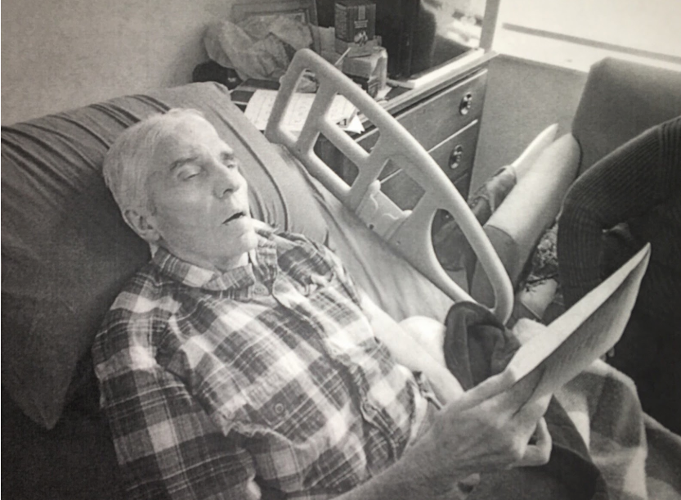

Challenge
Create a text to speech output for Don Loree to use in his everyday life to communicate with his friends and family
Includes large font keyboard
Plays audio when Don prompts it to
MEC Programming Challenge – Group 102

Slide 3
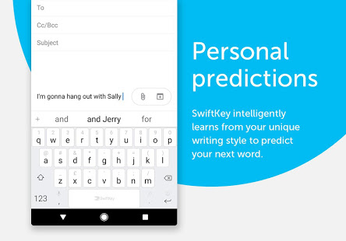
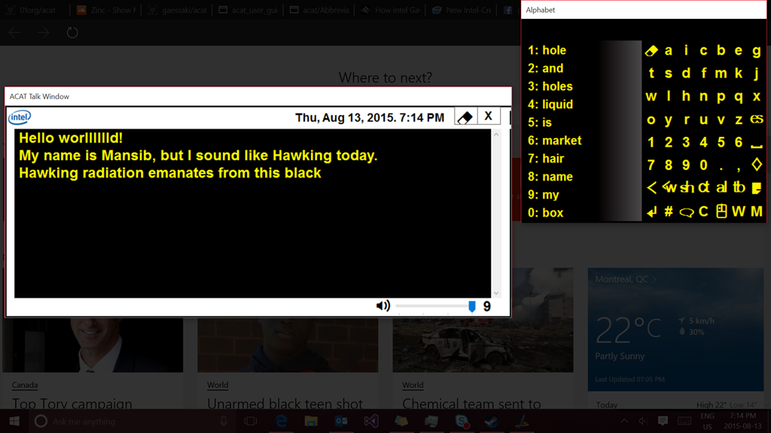

Inspiration
ACAT created by Intel and Stephan Hawking
SwiftKey’s predictive text
Life Alert
MEC Programming Challenge – Group 102

Slide 4
Our Design
Written in C# using Visual Studio
Is created specially for Don to use
Can be further customized to meet Don’s needs and the needs of his friends, family and caretaker
Has a main interface with a large font keyboard
Emergency, Help and Common buttons are also included in the Design
MEC Programming Challenge – Group 102

Slide 5
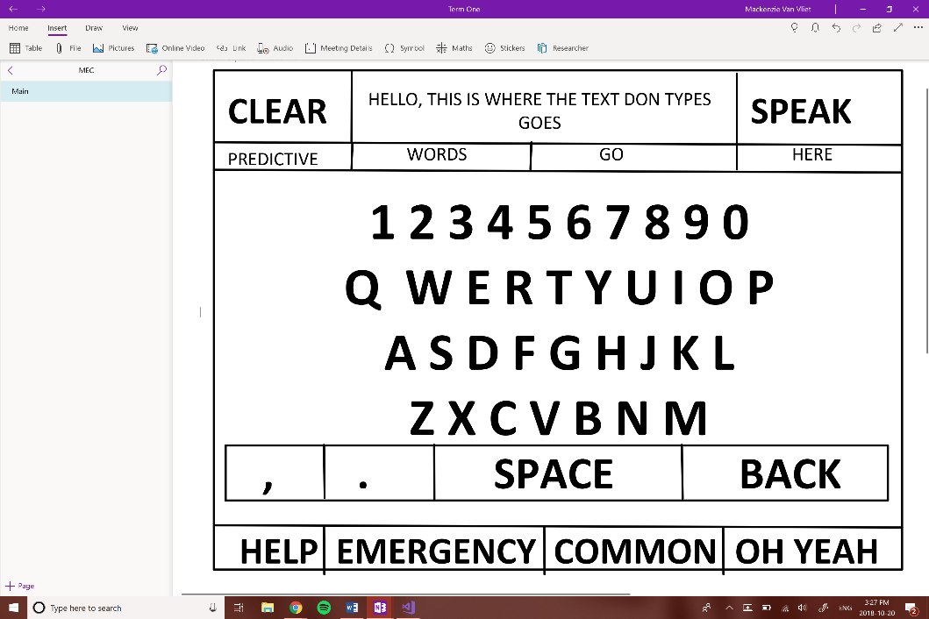
Main Interface Design
MEC Programming Challenge – Group 102

Slide 6
Components of Design
Keyboard Layout
Large font QWERTY layout with numbers on top
All capital letters
Period, comma, space, clear and back button
MEC Programming Challenge – Group 102

Slide 7

Components of Design
Text Display
Text display is just for Don to see what he typed before he ‘speaks”
People Don are speaking to can either read the text in the text display or listen to what he says
Can handle one line of speech
Speak button and clear is beside the text display so Don can review what he wants to say before he says it
MEC Programming Challenge – Group 102

Slide 8
Components of Design
Predictive Text
Default predictive text is: Yes, No, Okay
Predicts what word you are typing while typing
Predicts next word in sentence
Trained the predictive text with text files containing common English sentences
MEC Programming Challenge – Group 102

Slide 9

Components of Design
Text to Speech
Uses Speech Synthesis that is a library available in Windows 10
“Speaks” when the speak button is hit
MEC Programming Challenge – Group 102

Slide 10
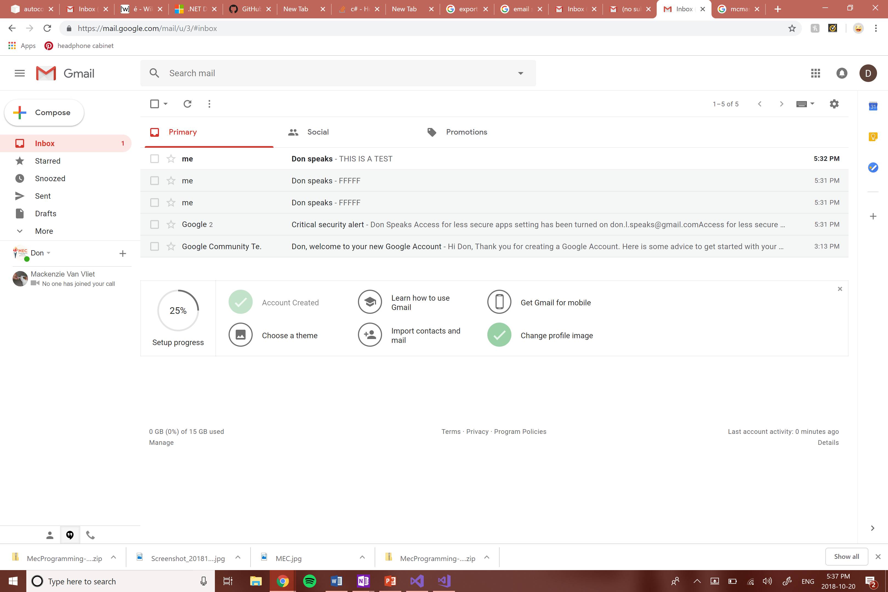
Components of Design
Email Notifications
Every time “Email” is pressed an email is sent out to a specific “Don Speaks” email
This is useful for when Don wants to communicate with people in other rooms
MEC Programming Challenge – Group 102

Slide 11
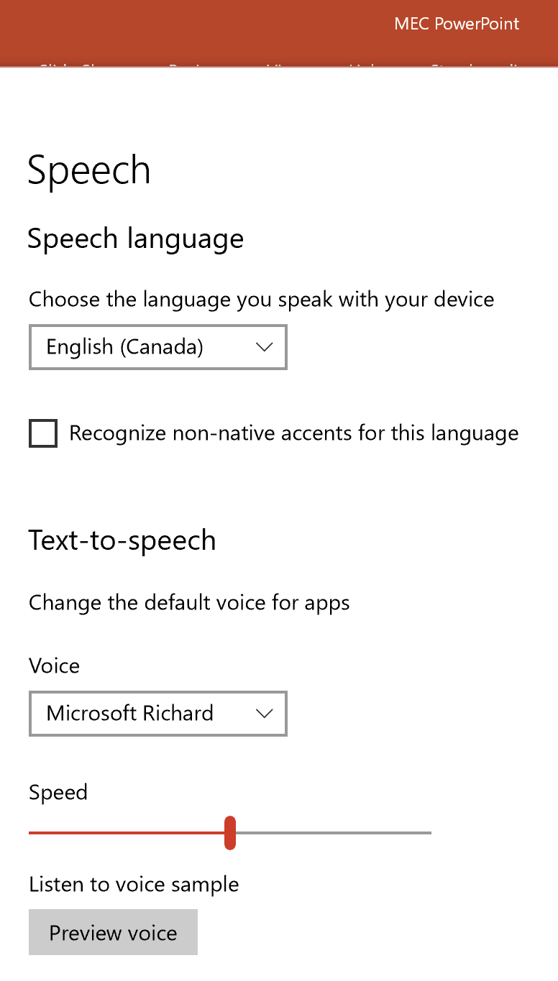

Components of Design
Voice
Uses computers built in text-to-speech voice
Family, friends and caretakers can download additional voices and set the voice to whatever they think suits Don best
MEC Programming Challenge – Group 102

Slide 12
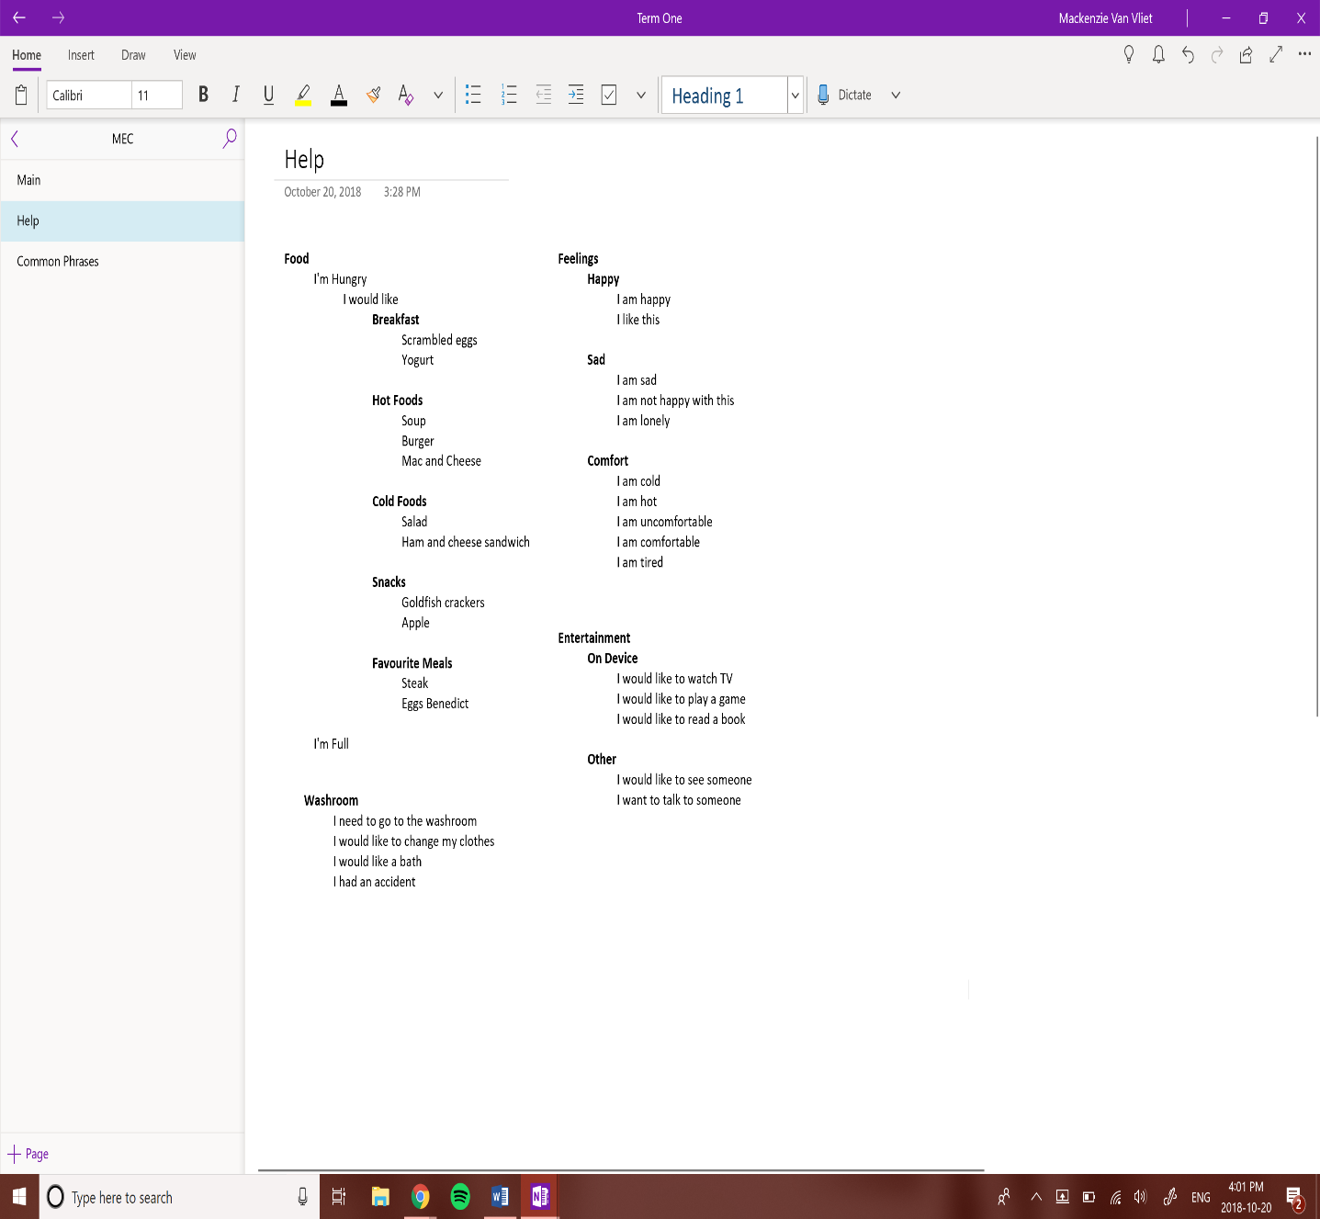
Components of Design
Help Button
Brings up Help menu that allows Don to choose what he needs help with
Help phrases can be added to meet Don’s needs
Is full of dropdown lists
MEC Programming Challenge – Group 102

Slide 13
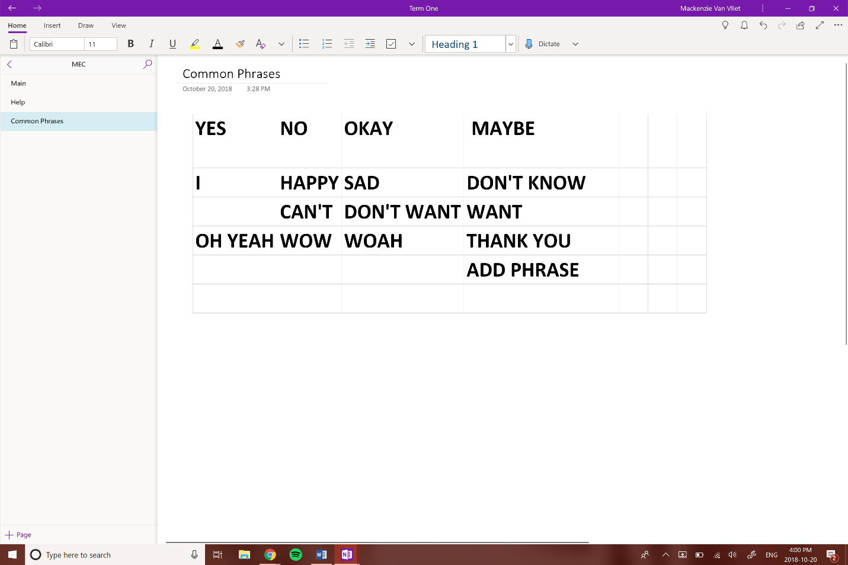

Components of Design
Common Phrases Button
Brings up Common Phrases menu full of Don’s favourite, common phrases
Phrases can be added to this menu by Don
The advantage of this is that some longer phrases it would be easier to search and find the phrase than type it all out
This is also similar to the current way of communication he has now
MEC Programming Challenge – Group 102

Slide 14


Components of Design
Emergency Button
Plays alarm at full volume
Google Hangout calls the email address
Activates Life Line
MEC Programming Challenge – Group 102

Slide 15
Programming Challenge
Don Loree’s Customizable Text to Speech Application
Paul Laffon, Cédric Paris, Omar Rabie, Mackenzie Van Vliet
{laffonp, parisc, rabieo, vanvlm1} @ mcmaster.ca
Group 102
DEMO
MEC Programming Challenge – Group 102

